Slide 1
Publicis Sapient Logo

Slide 2

Loan Application
February 22, 2024
Gandham Naveen

Slide 3
Agenda
Objective
Input format
Microservice Architecture
Implementation
Output screenshots

Slide 4
1. Objective
Design a Loan Application where we need to collect information from the Customers like First Name, Last Name, Fathers Name, Gender, Company Name, Emp ID, Designation, Phone Number, Loan Amount. This level aims to provide a foundational understanding of Nodejs and database connectivity.

Slide 5
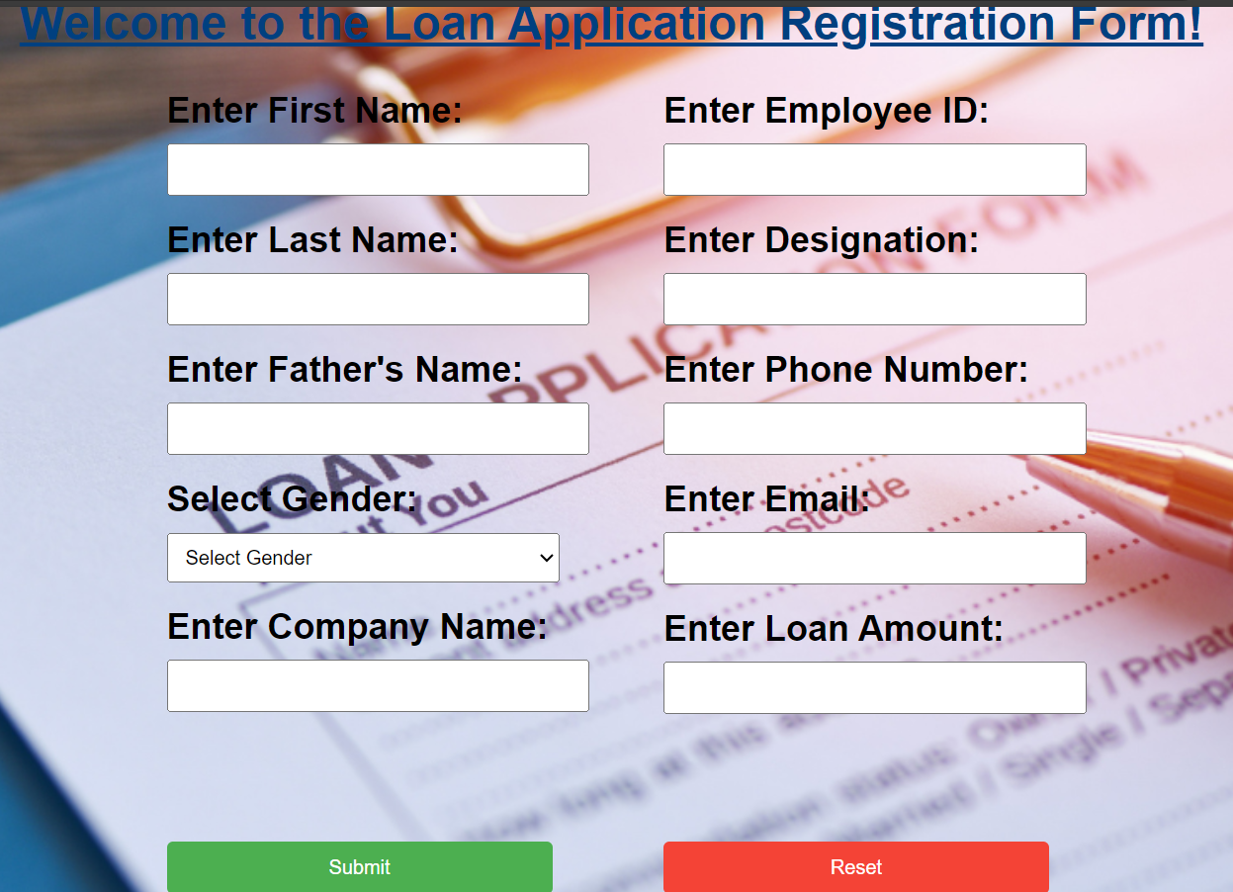
2. Input Format
First Name,
Last Name,
Fathers Name,
Gender,
Company Name,
Emp ID,
Designation,
Phone Number,
Loan Amount

Slide 6
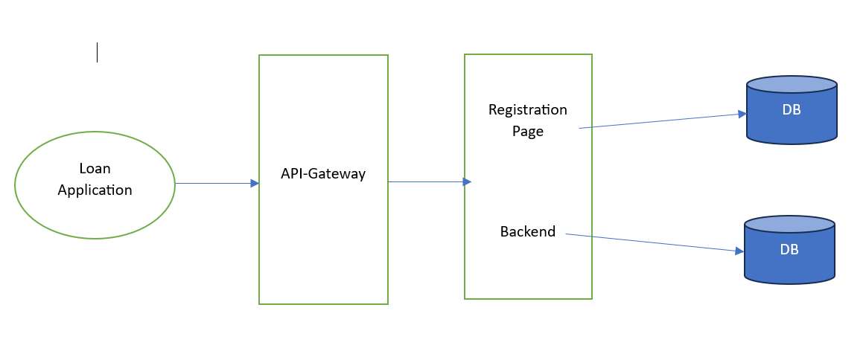
3. Microservice architecture

Slide 7
4.Implementation
Technologies and Libraries used
Nodejs
Express
Express-session
EJS
Body parser
MongoDB
Mongoose
Mongo Store
Connect-Mongo

Slide 8
DataBase
MongoDB is an open-source NoSQL database management program. NoSQL (Not only SQL) is used as an alternative to traditional relational databases.
Scalability. MongoDB supports vertical and horizontal scaling. Vertical scaling works by adding more power to an existing machine, while horizontal scaling works by adding more machines to a user's resources.
Schema-less. MongoDB is a schema-less database, which means the database can manage data without blueprint

Slide 9
Structure of the Application
Models – used to define schema
LoanApp.js
Views – EJS code for rendering dynamic HTML pages
register
Routes – for handling requests and route accordingly
App.js

Slide 10
Registration page
Users can register by using First Name, Last Name, Fathers Name, Gender, Company Name, Emp ID, Designation, Phone Number, Loan Amount.
To prevent duplicates customer details are saved in database with unique constraint of Emp ID and Email.

Slide 11
Linux Deployment
Create an AWS instance with Ubuntu OS
Connect to putty
Install apache2 web server
apt-get install apache2 –y
Start the server
service apache2 start
Create new directory in default path /var/www/html
Move into the directory
Give appropriate permissions required
chown -R 755 /var/www/html/web
chmod -R 755 /var/www/html/web

Slide 12
Linux Deployment
Create config file inside the directory and add required code
Here I am trying to create virtual host to host my application.
nano /etc/apache2/sites-available/web.conf
Run the following commands to enable the apache2 service for hosting
sudo a2ensite web.conf
sudo systemctl reload apache2
sudo a2dissite 000-default.conf
systemctl restart apache2
systemctl status apache2.service

Slide 13
Linux Deployment
Create file inside the following path and write the code of application
sudo nano /etc/hosts
vi index.html
Then go to public ip address of instance and run the same ip address in localhost.

Slide 14
8. Screenshots

Slide 15
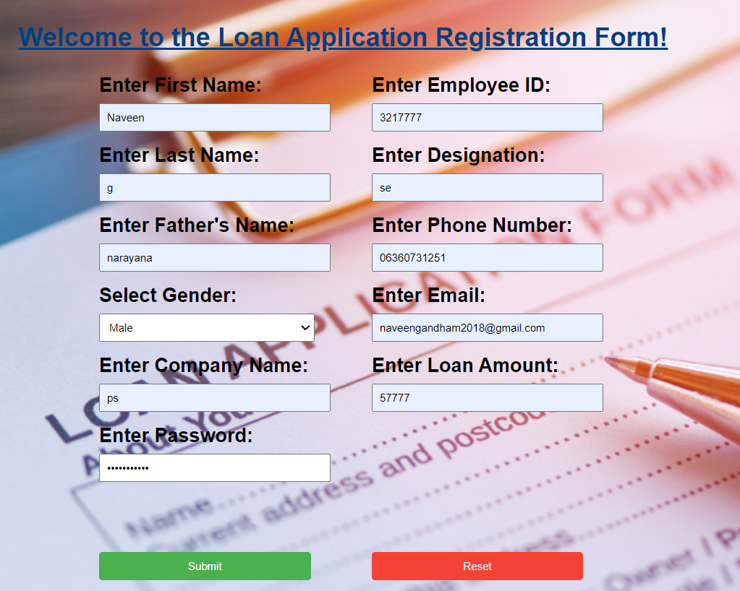
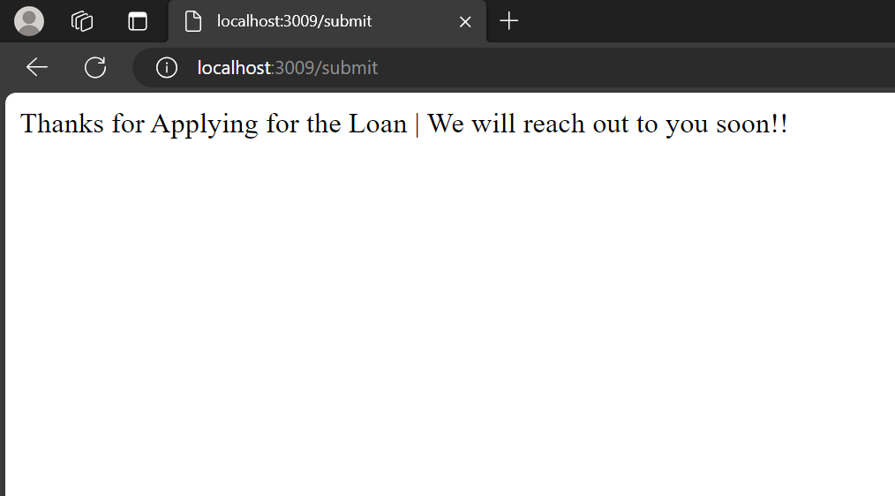

Slide 16
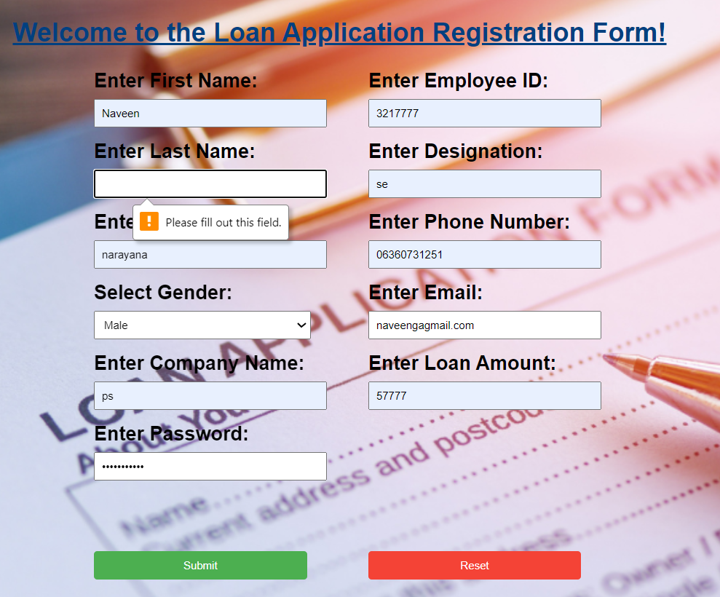

Slide 17
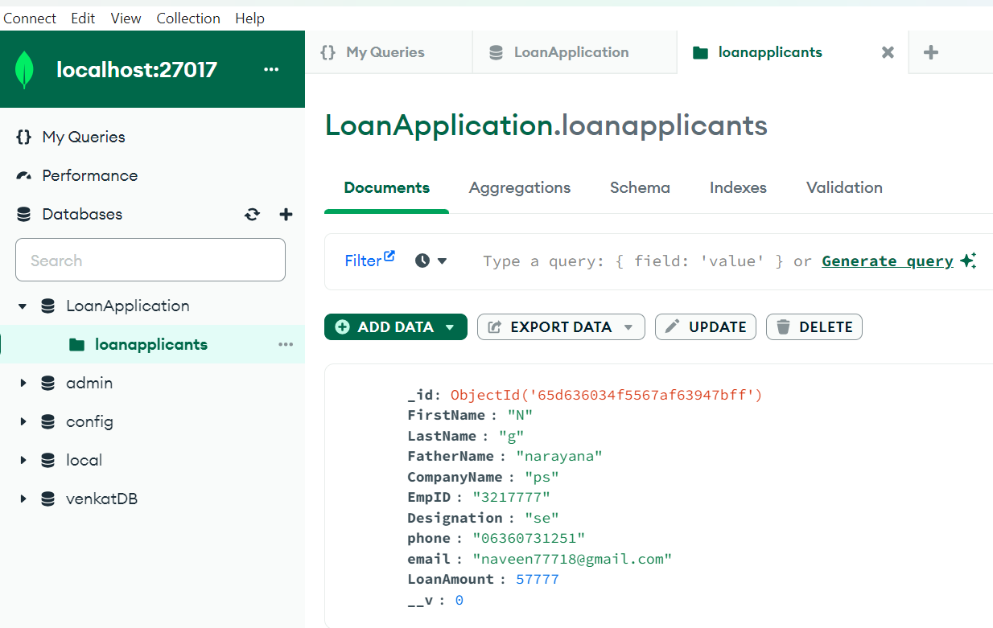
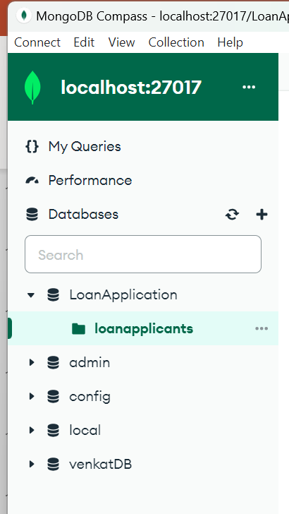

Slide 18
thank you
copyright publicis sapient | confidential

